Slide 1
Working code / software screenshots Iteration 1
Jackson Davis, Sanya Sinha, David Woolston

Slide 2
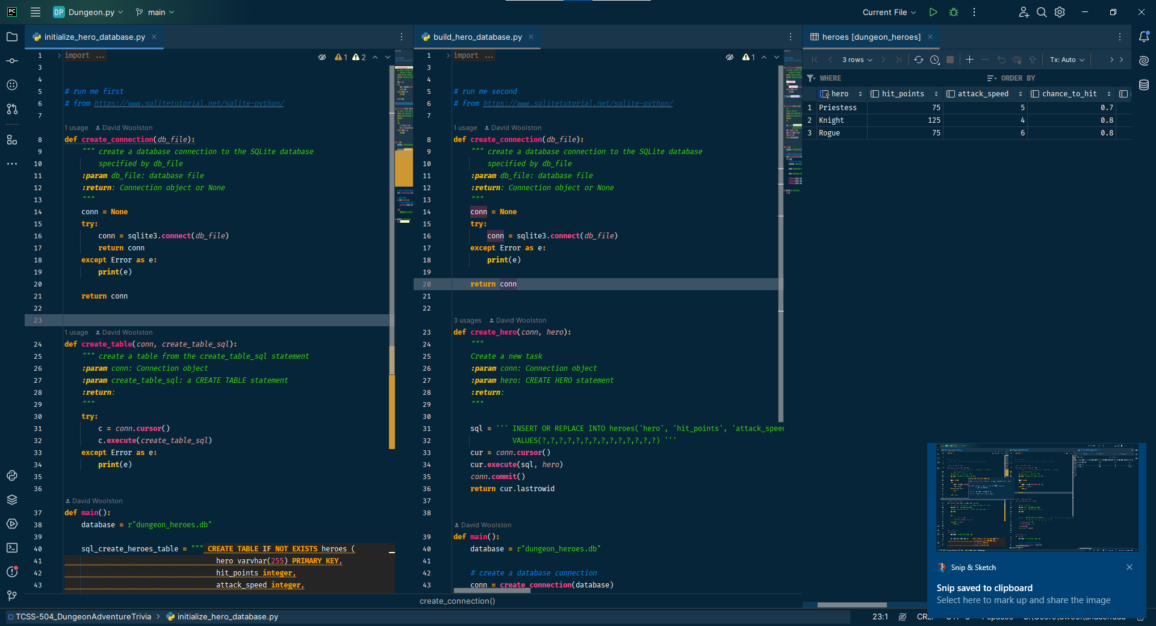
Initialize and build database of Hero parameter statistics

Slide 3
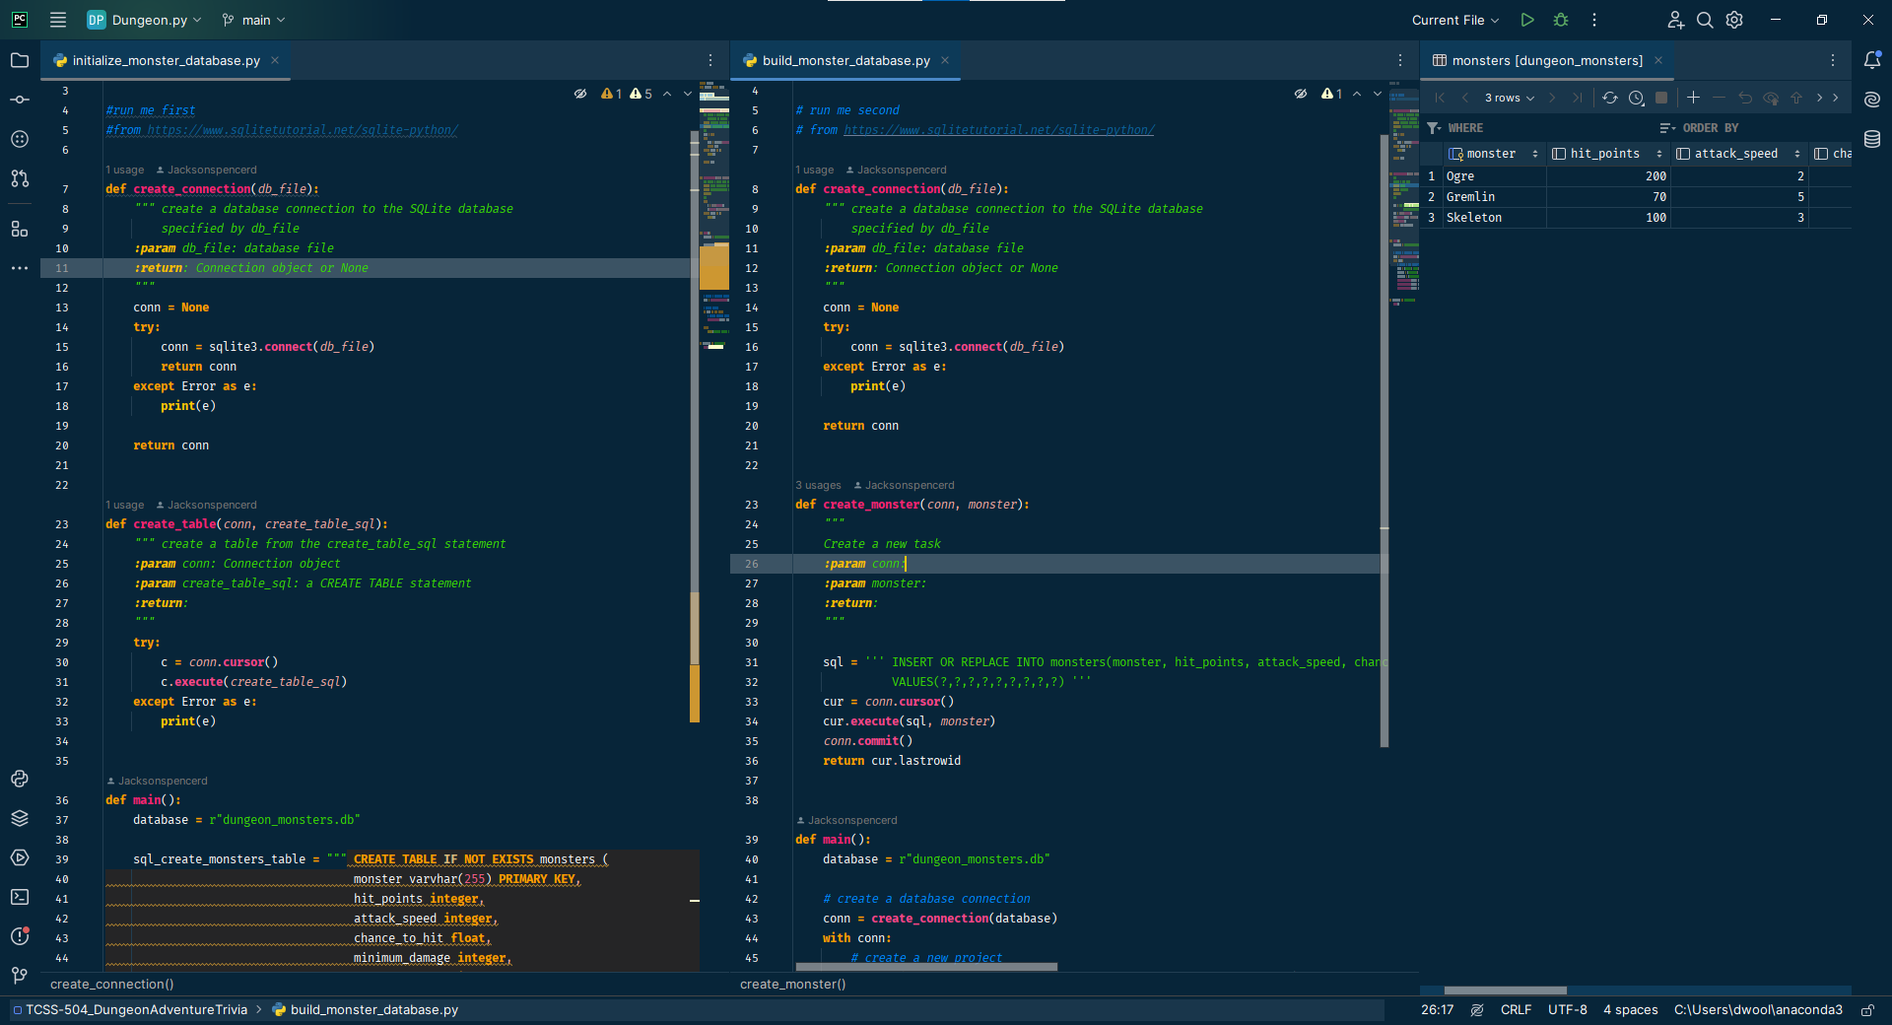
Initialize and build database of Monster parameter statistics

Slide 4
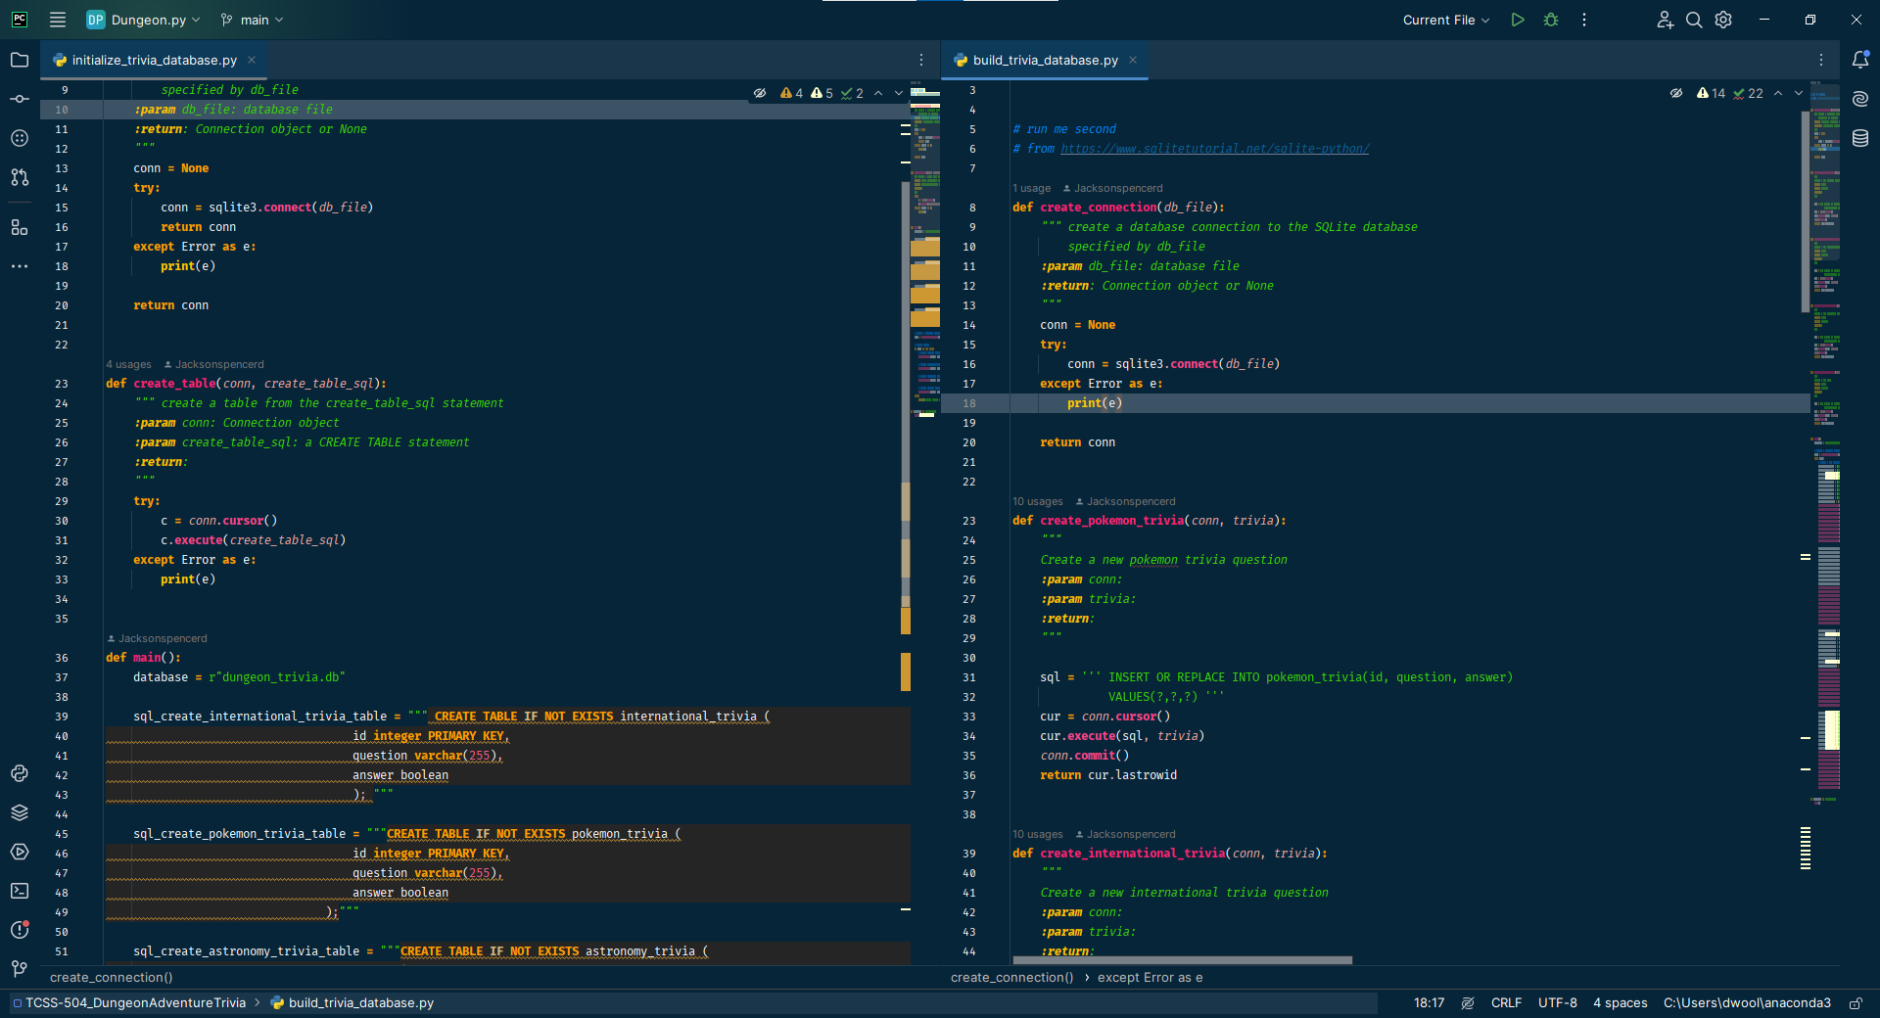
Initialize and build Trivia databases (1/2)

Slide 5
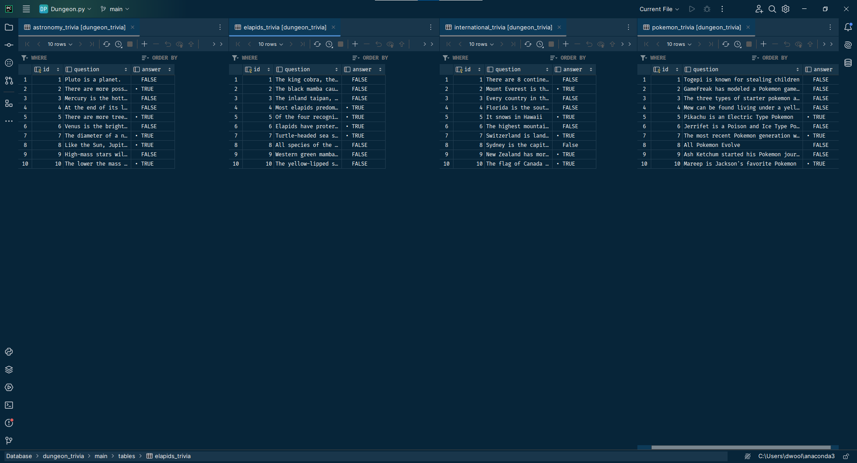
Initialize and build Trivia databases (2/2)

Slide 6
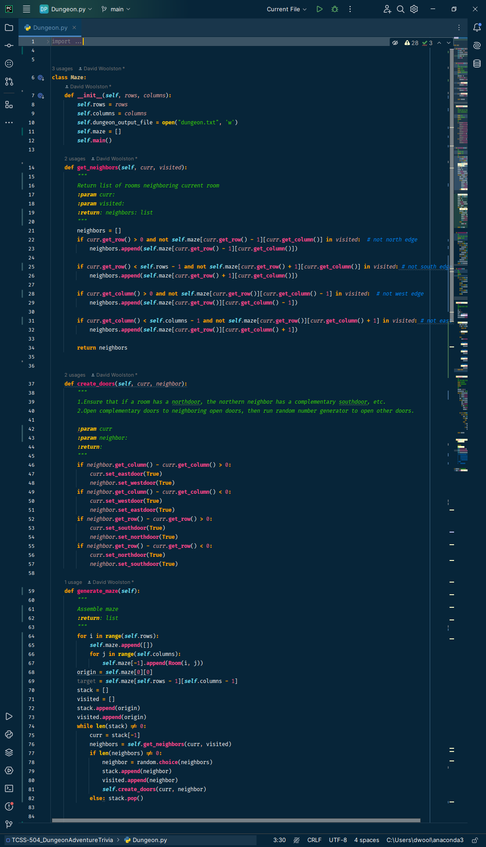
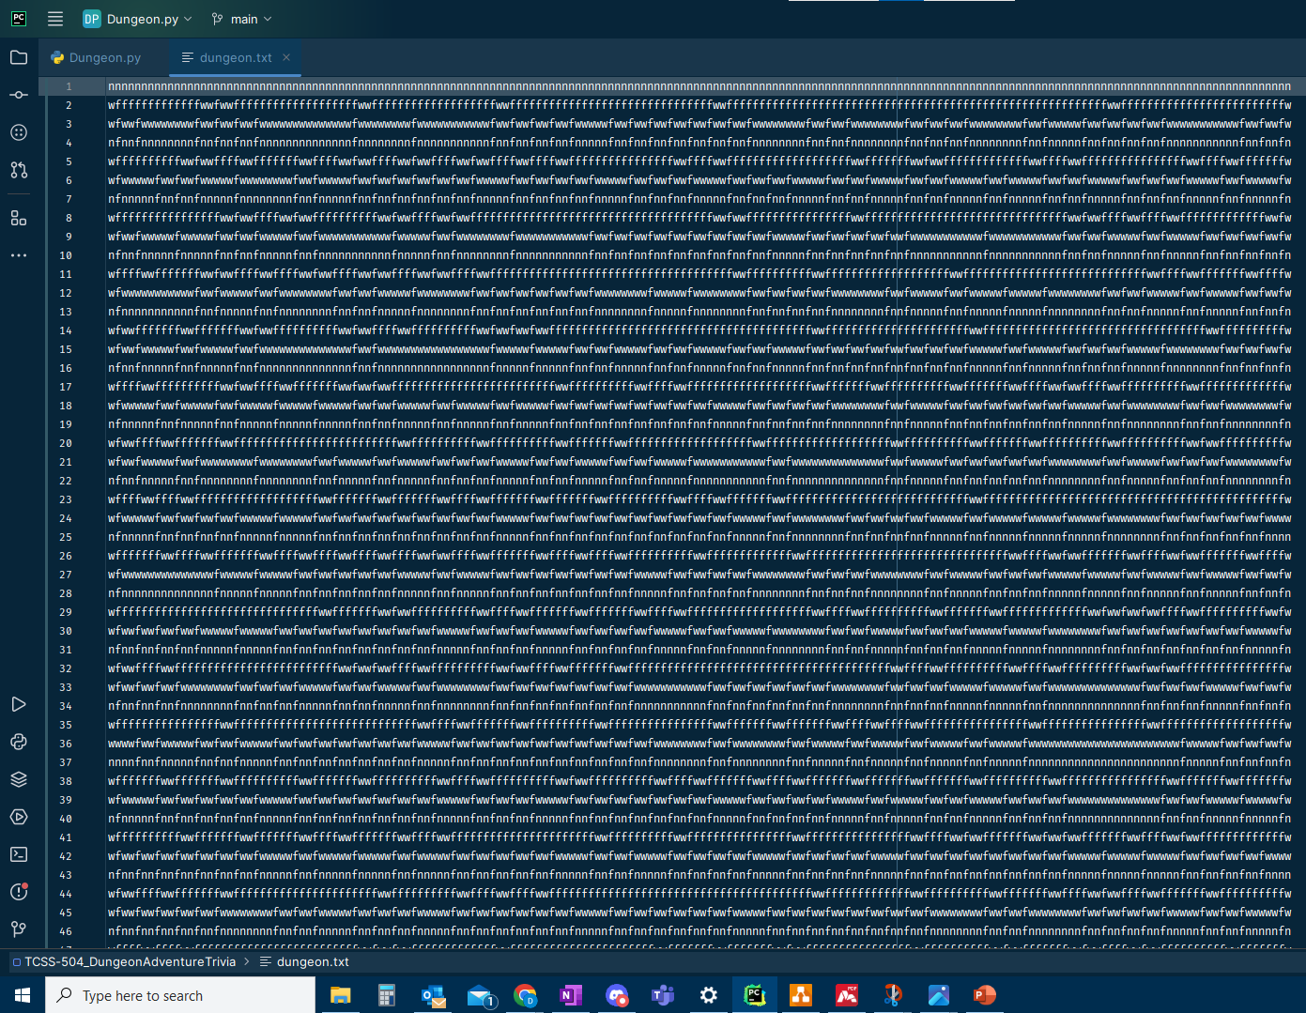
Generate maze in class Dungeon, write dungeon.txt for GUI

Slide 7
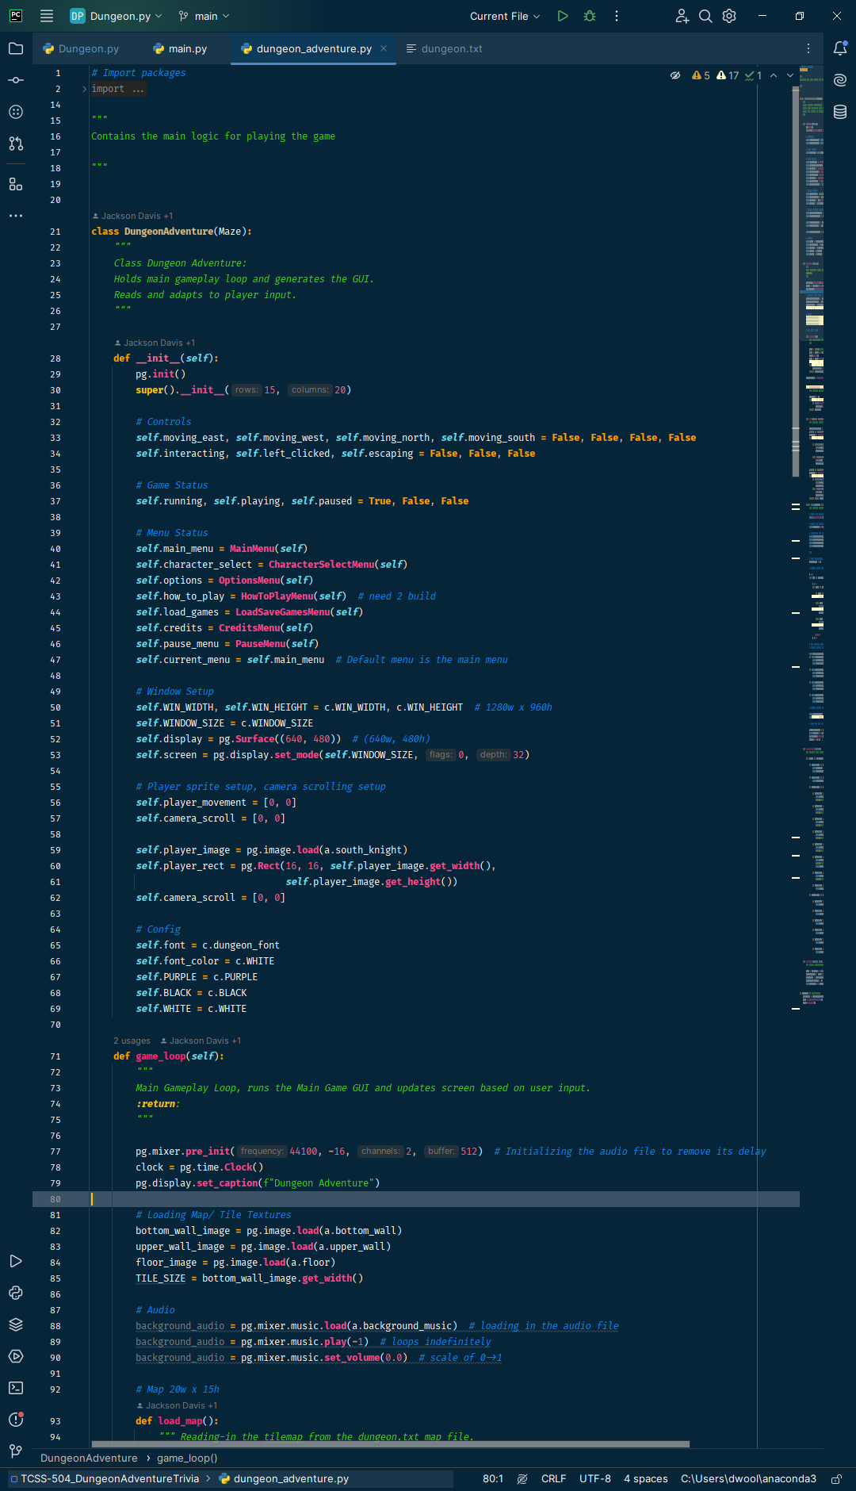
DungeonAdventure class: main game logic

Slide 8
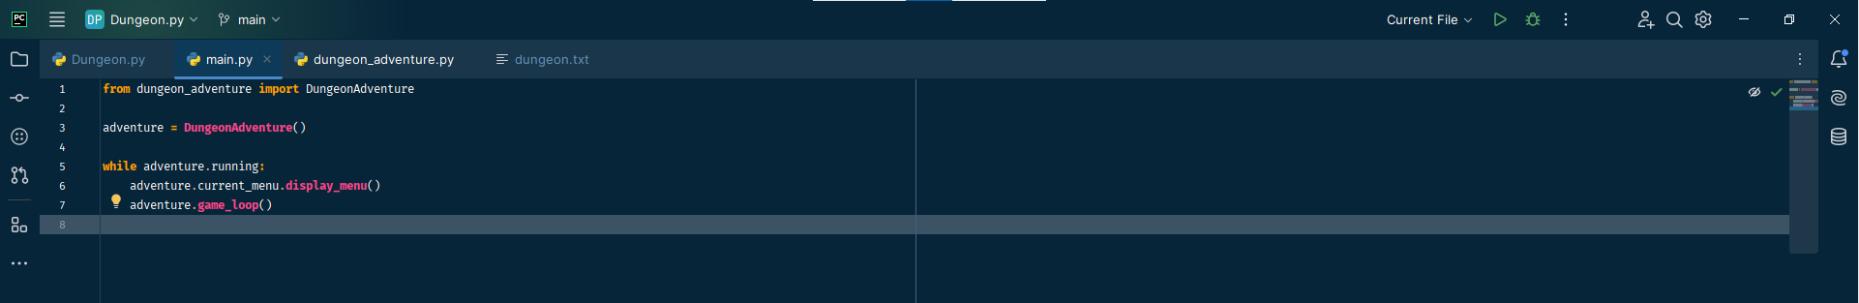
Main method to initiate gameplay

